Slide 1

Analysis of Algorithms
(Fall 2013)
Istanbul Technical University
Computer Eng. Dept.
Chapter 19
Binomial Heaps
Course slides from
Kevin Wayne @Princeton
have been used in preparation of these slides.
Last updated: December 23, 2009

Slide 2
Purpose
Understand data structures known as mergeable heaps that can support
  MAKE-HEAP(), INSERT(H, x), MINIMUM(H), EXTRACT-MIN(H), UNION(H₁, H₂)
  DECREASE-KEY(H, x, k), DELETE(H, x)

Slide 3
Outline
Binomial Trees and Binomial Heaps
Operations on Binomial Heaps
  Creating New Binomial Heap
  Finding Minimum Key
  Uniting Two Binomial Heaps
  Inserting Node
  Extracting Node with Minimum Key
  Deleting Key
  Decreasing Key

Slide 4
Priority Queues
Supports following operations
  Insert element x
  Return min element
  Return and delete minimum element
  Decrease key of element x to k
Applications
  Dijkstra's shortest path algorithm
  Prim's MST algorithm
  Event-driven simulation
  Huffman encoding
  Heapsort, etc.

Slide 5
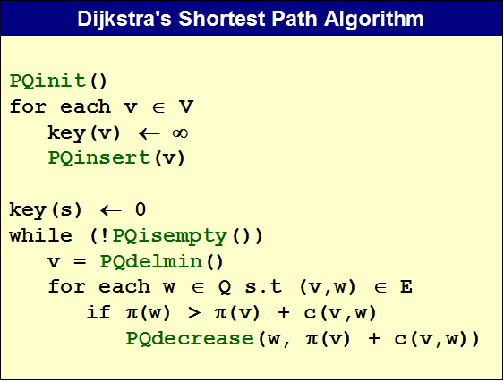
Priority Queues in Action

Slide 6
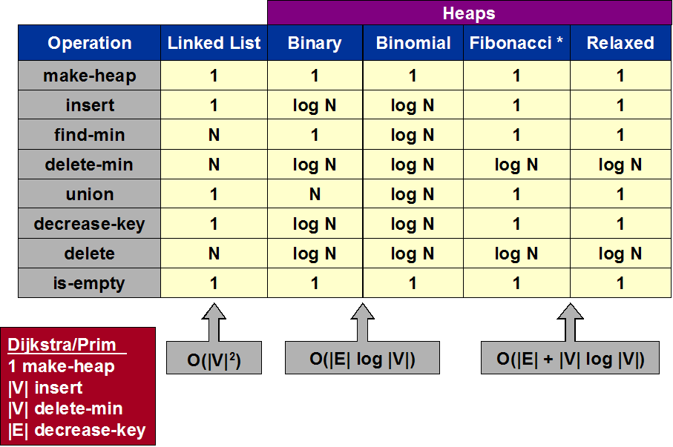
Priority Queues

Slide 7
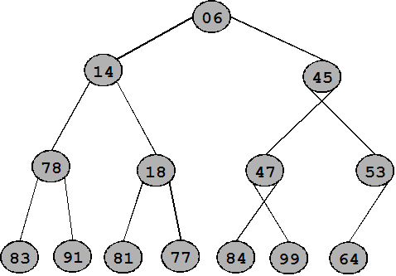
Binary Heap: Definition
Almost complete binary tree
  filled on all levels, except last, where filled from left to right
Min-heap ordered
  every child greater than (or equal to) parent

Slide 8
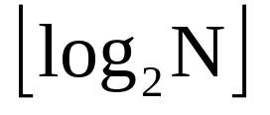
Binary Heap: Properties
Min element is in root
Heap with N elements has height =
N = 14
Height = 3

Slide 9

Implementing Binary Heaps:
Array Implementation
Use an array: no need for explicit parent or child pointers.
  Parent(i) =
  Left(i) = 2i
  Right(i) = 2i + 1
1
2
3
4
5
6
7
8
9
10
11
12
13
14

Slide 10
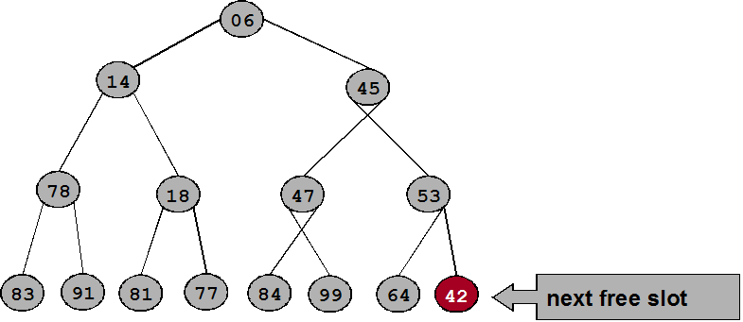
Binary Heaps: Insertion
Insert element x into heap
  Insert into next available slot
  Bubble up until it is heap ordered

Slide 11
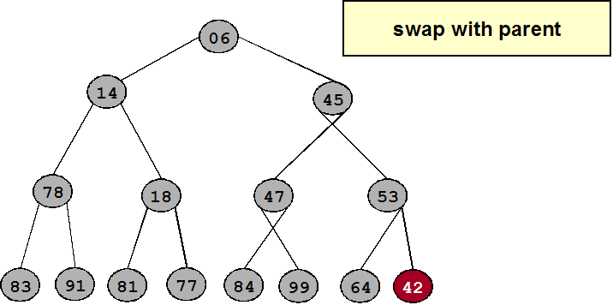
Binary Heaps: Insertion
Insert element x into heap
  Insert into next available slot
  Bubble up until it is heap ordered

Slide 12
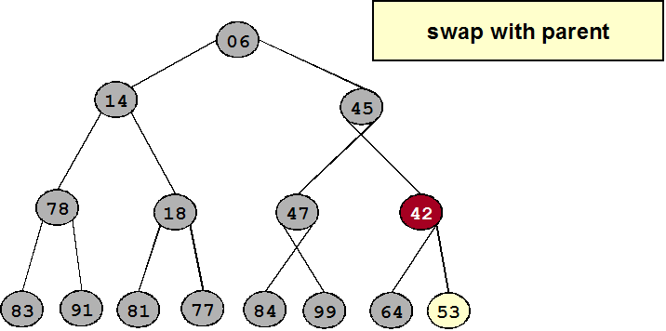
Binary Heaps: Insertion
Insert element x into heap
  Insert into next available slot
  Bubble up until it is heap ordered

Slide 13
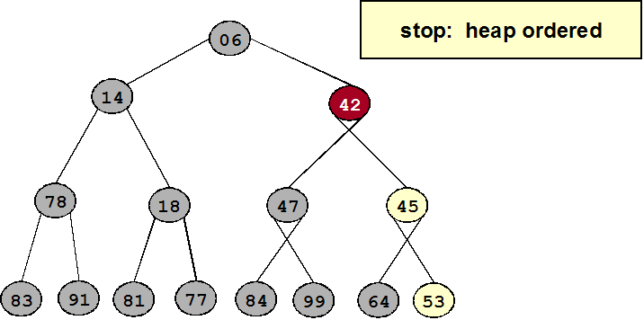
Binary Heaps: Insertion
Insert element x into heap
  Insert into next available slot
  Bubble up until it is heap ordered
  O(logn) operations

Slide 14
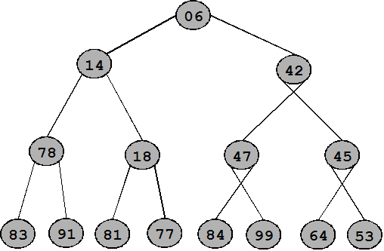
Binary Heaps: Decrease Key
Decrease key of element x to k
  Bubble up until it is heap ordered
  O(logn) operations

Slide 15
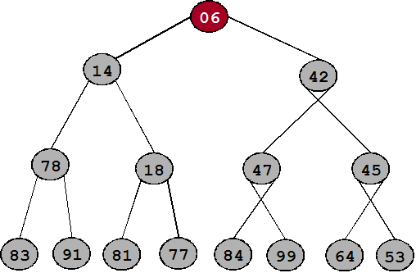
Binary Heaps: Delete Min
Delete minimum element from heap
  Exchange root with rightmost leaf
  Bubble root down until it is heap ordered

Slide 16
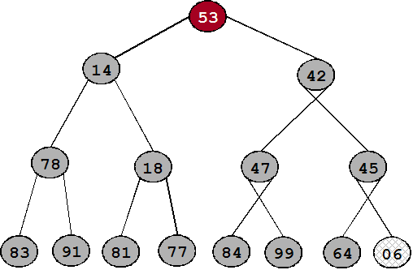
Binary Heaps: Delete Min
Delete minimum element from heap
  Exchange root with rightmost leaf
  Bubble root down until it is heap ordered

Slide 17
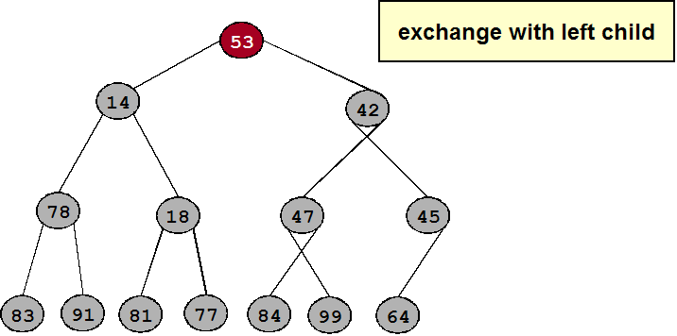
Binary Heaps: Delete Min
Delete minimum element from heap
  Exchange root with rightmost leaf
  Bubble root down until it is heap ordered

Slide 18
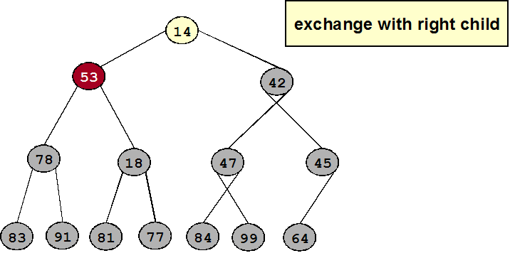
Binary Heaps: Delete Min
Delete minimum element from heap
  Exchange root with rightmost leaf
  Bubble root down until it is heap ordered

Slide 19
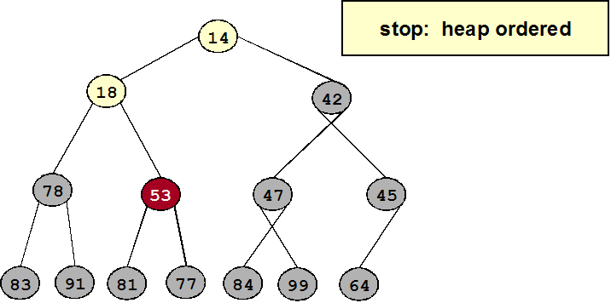
Binary Heaps: Delete Min
Delete minimum element from heap
  Exchange root with rightmost leaf
  Bubble root down until it is heap ordered
  O(logn) operations

Slide 20
Binary Heaps: Heapsort
Insert N items into binary heap
Perform N delete-min operations
O(N log N) sort
No extra storage

Slide 21

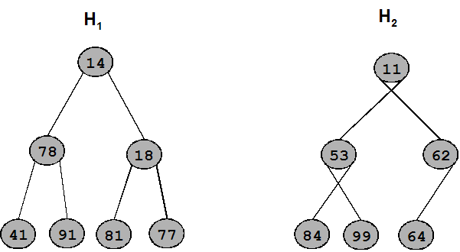
Binary Heaps: Union
Combine two binary heaps H₁ and H₂ into single heap
No easy solution
  operations apparently required (Remember BUILD-MAX-HEAP’s running time of O(N) for inserting N items.)
Can support fast union with fancier heaps:
  Binomial Heaps
  Fibonacci Heaps

Slide 22
Mergeable Heap Operations
MAKE-HEAP()
INSERT(H,x)
MINIMUM(H)
EXTRACT-MIN(H)
UNION(H1,H2)
DECREASE-KEY(H,x,k)
DELETE(H,x)
H: heap, x: node in the heap, k: key value
Inefficient search operation

Slide 23
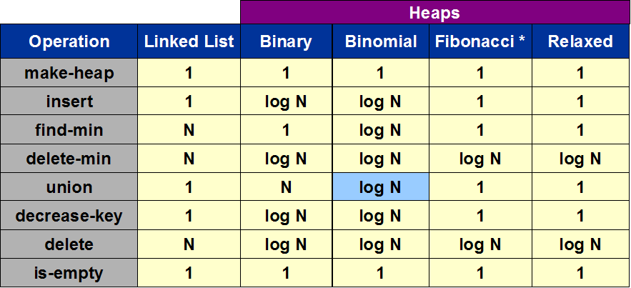
Priority Queues

Slide 24
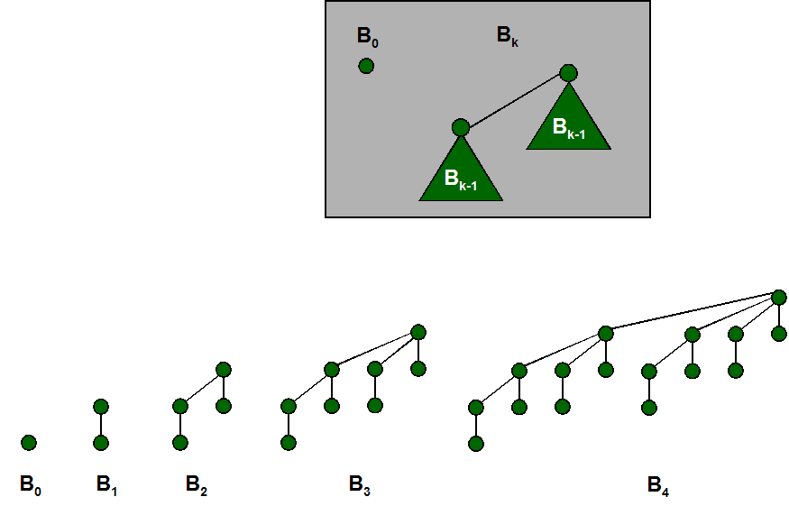
Binomial Tree
Recursive definition

Slide 25
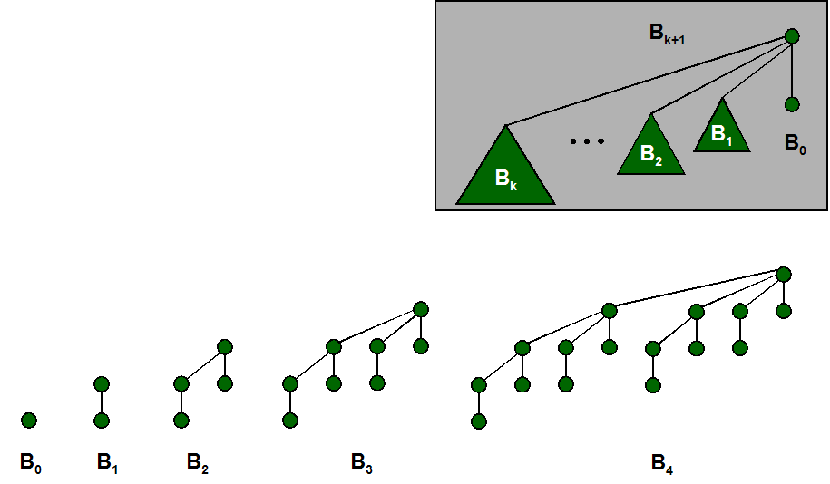
Binomial Tree
Useful properties of order k binomial tree B_{k}
  Number of nodes = 2^{k}
  Height = k
  Degree of root = k
  Deleting root yields binomial
  trees B_{k-1}, … , B₀
Proof:
  By induction on k

Slide 26
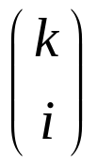
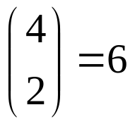
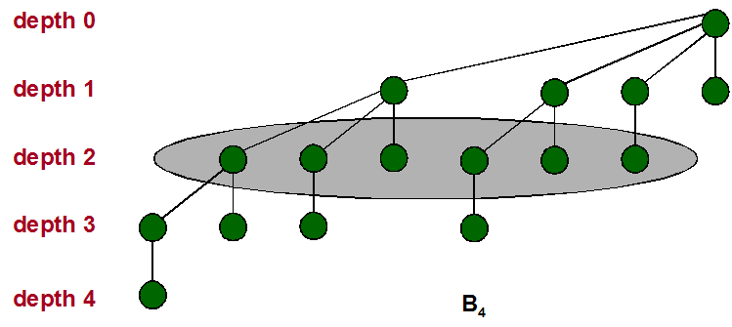
Binomial Tree
A property useful for naming the data structure
B_{k} has nodes at depth i

Slide 27
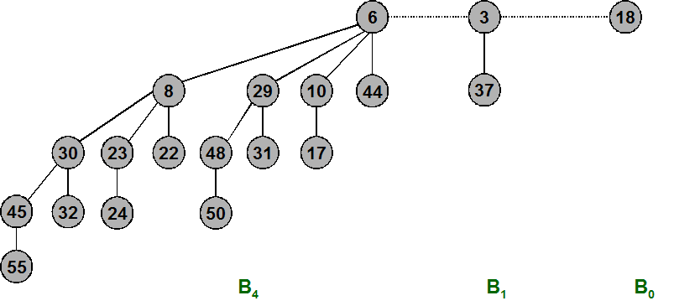
Binomial Heap
Vuillemin, 1978
Sequence of binomial trees that satisfy binomial heap property
  each tree is min-heap ordered
  0 or 1 binomial tree of order k

Slide 28
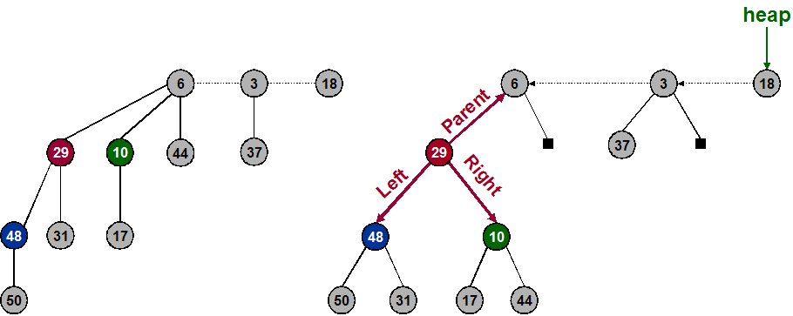
Binomial Heap: Implementation
Represent trees using left-child, right sibling pointers [Ch. 10.4]
  three links per node (parent, left, right)
Roots of trees connected with singly linked list
  degrees of trees strictly decreasing from left to right

Slide 29
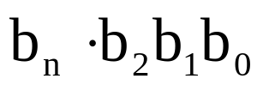

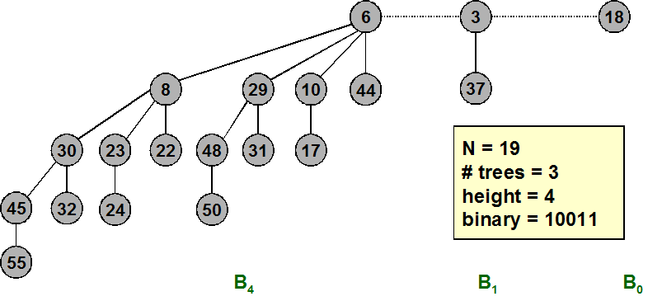

Binomial Heap: Properties
Properties of N-node binomial heap
  Min key contained in root of B₀, B₁, . . . , B_{k}
  Contains binomial tree B_{i} iff b_{i} = 1 where is binary representation of N
  At most binomial trees
  Height

Slide 30
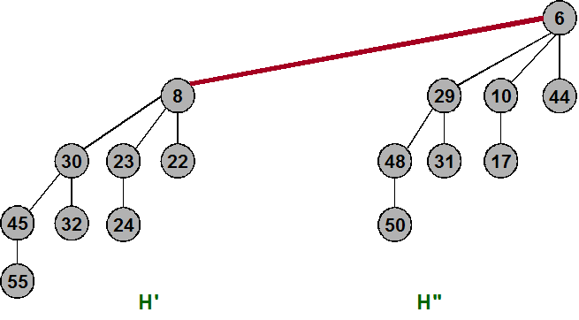
Binomial Heap: Union
Create heap H that is union of heaps H' and H''
  "Mergeable heaps"
  Easy if H' and H'' are each order k binomial trees
    connect roots of H' and H''
    choose smaller key to be root of H

Slide 31
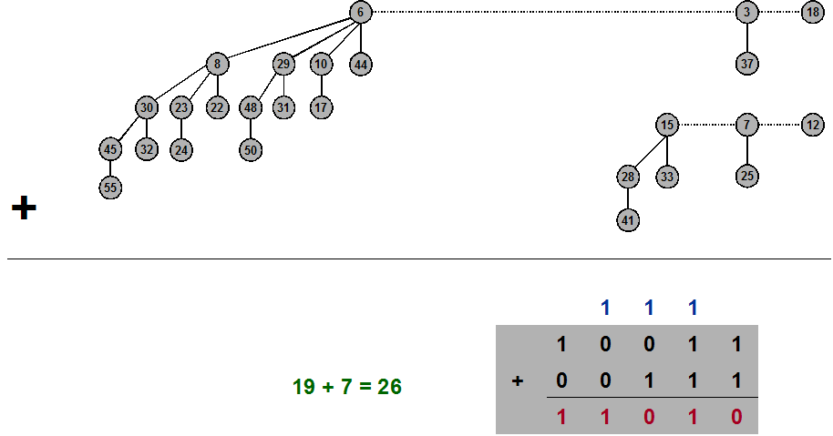
Binomial Heap: Union

Slide 32
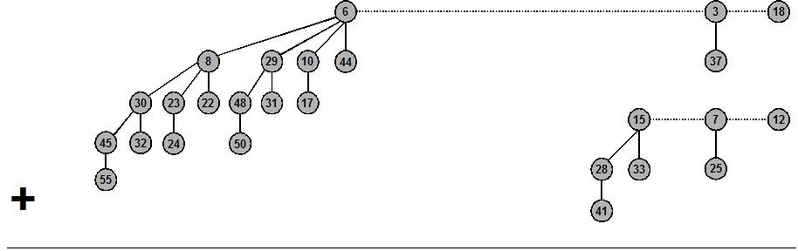
Binomial Heap: Union

Slide 33
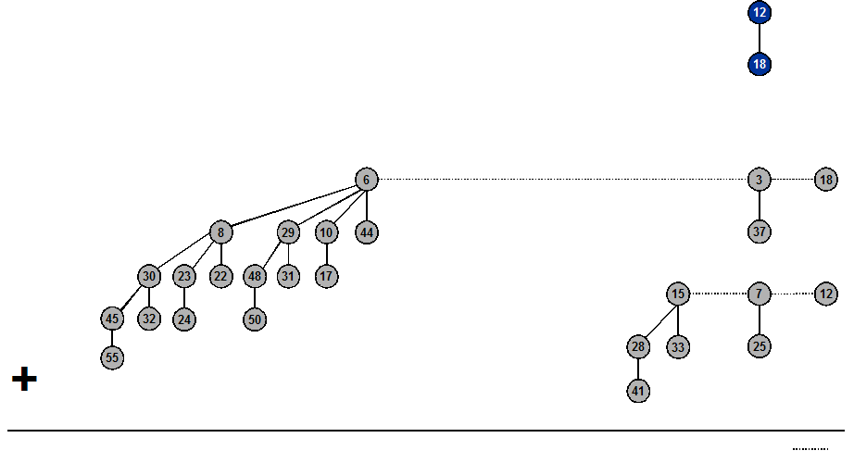
Binomial Heap: Union

Slide 34
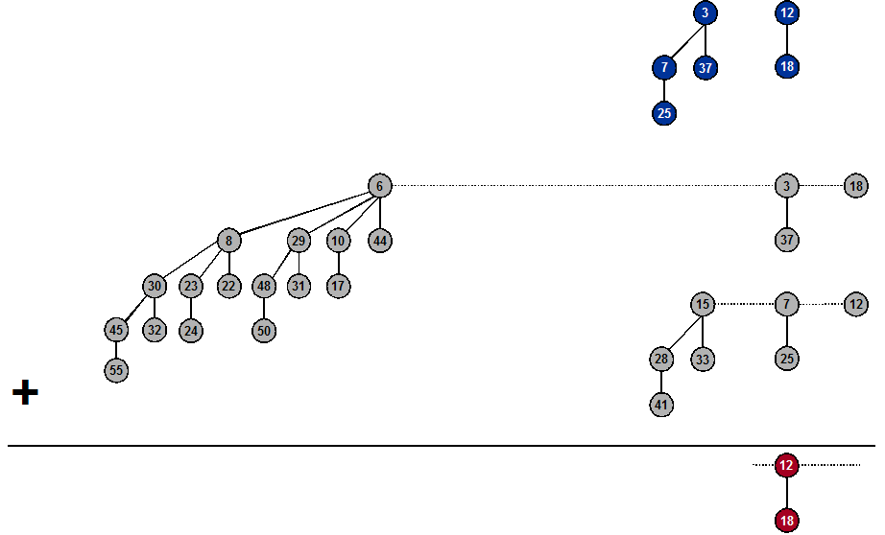
Binomial Heap: Union

Slide 35
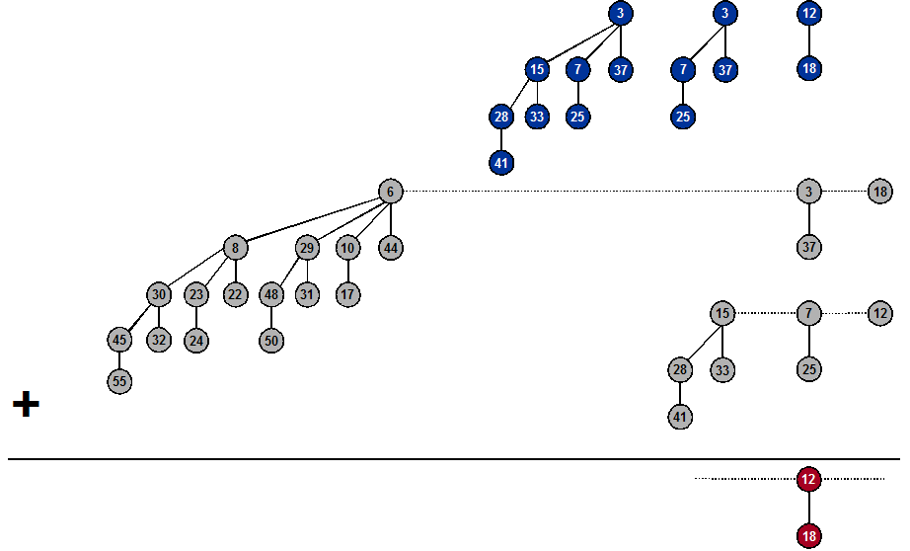
Binomial Heap: Union

Slide 36
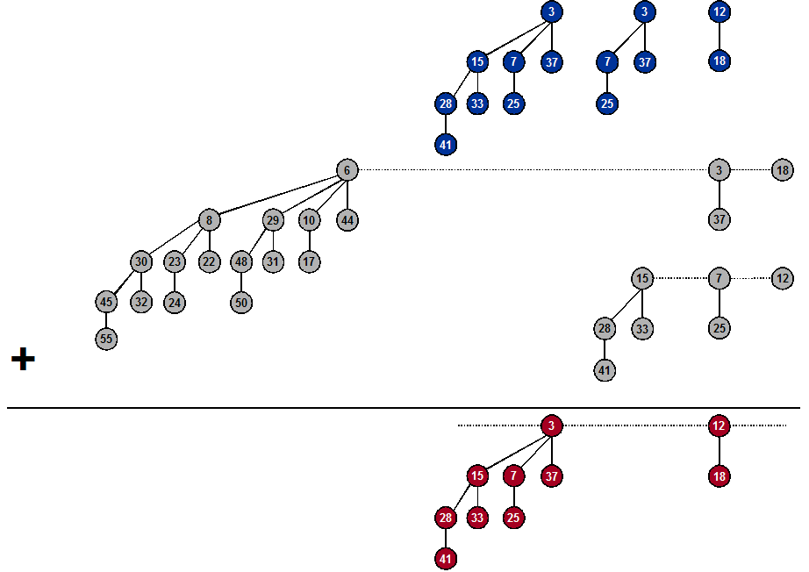
Binomial Heap: Union

Slide 37
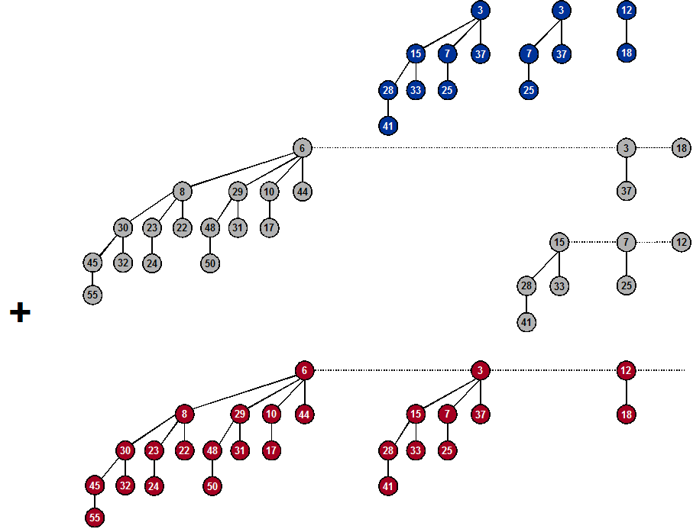
Binomial Heap: Union

Slide 38

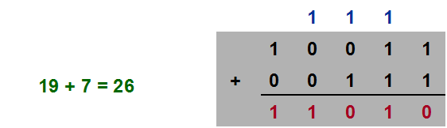
Binary Heaps: Union
Create heap H that is union of heaps H' and H''
  Analogous to binary addition
Running time: O(log N)
  Proportional to number of trees in root lists

Slide 39
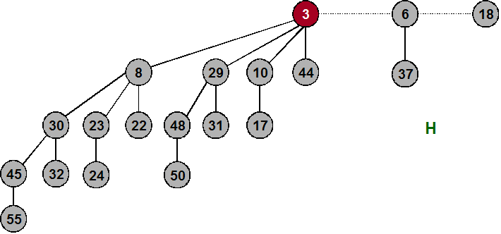
Binary Heaps: Delete Min
Delete node with minimum key in binomial heap H
  Find root x with min key in root list of H, and delete
  H' ← broken binomial trees
  H ← Union(H', H)
Running time: O(log N)

Slide 40
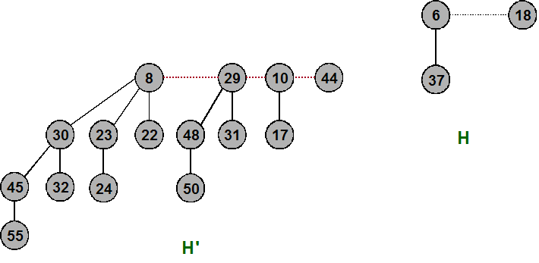
Binary Heaps: Delete Min
Delete node with minimum key in binomial heap H
  Find root x with min key in root list of H, and delete
  H' ← broken binomial trees
  H ← Union(H', H)
Running time: O(log N)

Slide 41
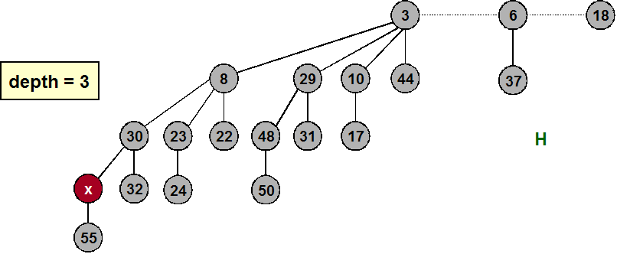
Binary Heaps: Decrease Key
Decrease key of node x in binomial heap H
  Suppose x is in binomial tree B _{k}
  Bubble node x up the tree if x is too small
Running time: O(log N)
  Proportional to depth of node

Slide 42
Binomial Heaps: Delete
Delete node x in binomial heap H.
  Decrease key of x to -∞
  Delete min
Running time: O(log N)

Slide 43
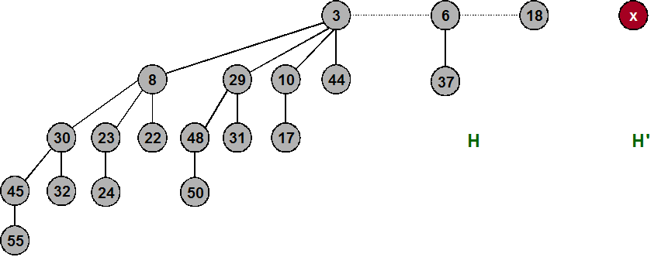
Binomial Heaps: Insert
Insert a new node x into binomial heap H
  H' ← MakeHeap(x)
  H ← Union(H', H)
Running time: O(log N)

Slide 44
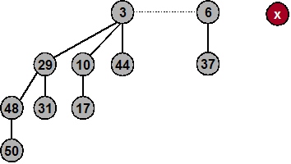


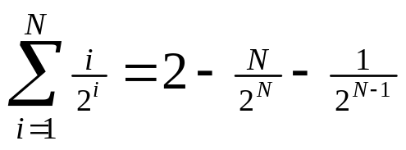

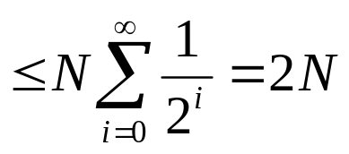
Binomial Heaps:
Sequence of Inserts
Insert a new node x into binomial heap H
  If N = .......0, then only 1 steps
  If N = ......01, then only 2 steps
  If N = .....011, then only 3 steps
  If N = ....0111, then only 4 steps
Inserting 1 item can take time
  If N = 11...111, then steps
But, inserting sequence of N items takes O(N) time!
  (N/2)(1) + (N/4)(2) + (N/8)(3) + . . . ≤ 2N
  Amortized analysis
  Basis for getting most operations
  down to constant time

Slide 45
Amortized Analysis
Worst-case analysis
  Analyze running time as function of worst input of a given size
Average case analysis
  Analyze average running time over some distribution of inputs
  Ex: quicksort
Amortized analysis
  Worst-case bound on sequence of operations
  Ex: splay trees, union-find
Competitive analysis
  Make quantitative statements about online algorithms
  Ex: paging, load balancing

Slide 46
Binomial Heap Operations
MAKE-HEAP()
INSERT(H,x)
MINIMUM(H)
EXTRACT-MIN(H)
UNION(H1,H2)
DECREASE-KEY(H,x,k)
DELETE(H,x)
MAKE-HEAP() [Trivial, just create an object H, head[H]=nil]
MINIMUM(H) [Trivial: Return the minimum among binomial tree roots in the binomial heap]

Slide 47
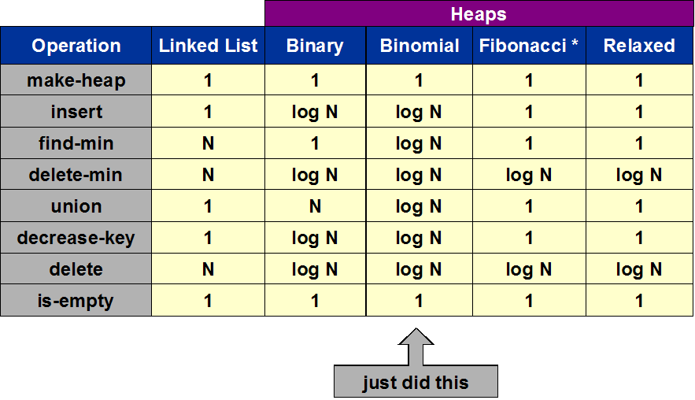
Priority Queues

Slide 48
Summary
Binomial Trees and Binomial Heaps
Operations on Binomial Heaps
  Creating New Binomial Heap
  Finding Minimum Key
  Uniting Two Binomial Heaps
  Inserting Node
  Extracting Node with Minimum Key
  Deleting Key
  Decreasing Key

